Slide 1
Research Paper Recommendation

Slide 2
Agenda
Introduction
Feature Engineering
Chatbot
1
3
5
2
4
6
Dataset
Modeling
Conclusion

Slide 3
Introduction
1

Slide 4

Dataset
2

Slide 5
Dataset
Tittle | Abstract | CS | Math | Phy | Stat
Pseudo and quasi Gluon PDF in the BFKL approxi... | I study the behavior of the gauge-invariant ... | 0 | 0 | 1 | 0
PeCo: Perceptual Codebook for BERT Pre-trainin... | This paper explores a better codebook for BE... | 1 | 0 | 0 | 0
… | … | … | … | … | …
Kaggle, published by Cornell University

Slide 6
Data Preparation & Feature Engineering
Data preparation:
Only include publications of : Math, physics, statistics or computer science (or combinations of them)
Published after 2010
Iterative stratification for train-test splits
Feature extraction:
Concatenate title and abstract
Remove stop words and special characters
Extract TF-IDF and LDA features

Slide 7
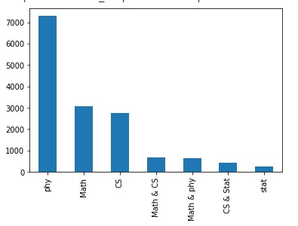
Dataset Distribution

Slide 8
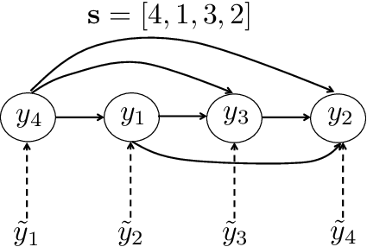
Modeling- Multilabel classification
1. Label Powerset:
Transform to multiclass classification
leads to class imbalance
Ex: 1, 0, 1, 1 -> 1011
2. Transformation to binary classification
Train a binary classifier on each column
Doesn’t take into account correlations
3. Classifier Chains
Binary labels are predicted sequentially
Output from binary classifier is fed to next one
Example of classifier chain
Source: Efficient Monte Carlo Methods for Multi-Dimensional Learning with Classifier Chains

Slide 9
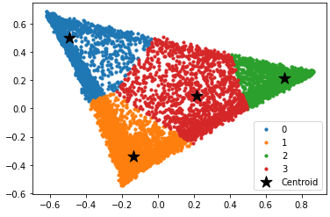
K-means Clustering
Data with Four Cluster

Slide 10
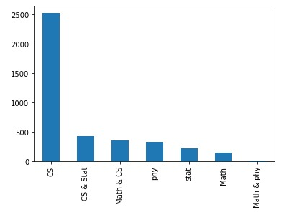
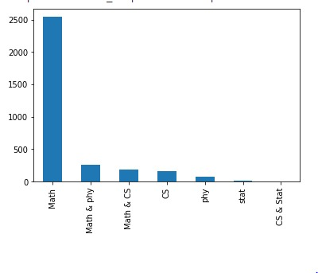
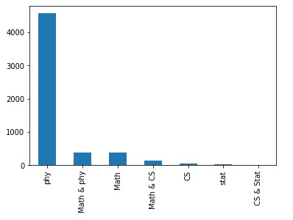
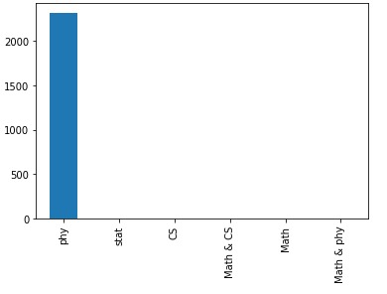
K-means Clustering
Cluster 0
Cluster 2
Cluster 1
Cluster 3

Slide 11
Models Accuracy
 | Chain Classifier with logistic regression | Chain Classifier with K means
Test Accuracy | 83 % | 83.2%
Hamming loss | 0.058 | 0.057
 | Cluster 0 | Cluster 1 | Cluster 2 | Cluster 4
Test Accuracy | 71.6% | 86.8% | 77.6% | 99.5%
Hamming loss | 0.095 | 0.044 | 0.08 | 0.002

Slide 12

Chatbot

Slide 13
Recommendation
recommendation
Title
categories
Optimization
search for most similar paper
Search for similar papers based on main & sub categories
acquire its features (tfidf-LDA - cluster num)
classifier
filter the paper cluster by the label
calculate cosine similarity (tfidf - LDA)
get n-Top similar papers titles

Slide 14
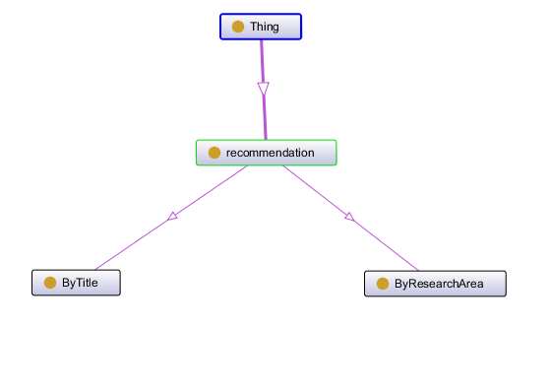
Chatbot

Slide 15
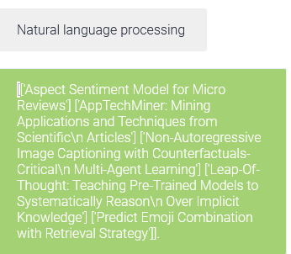
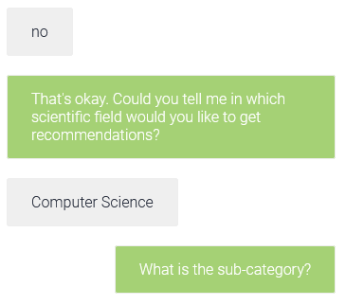

Chatbot

Slide 16
Thanks!
Any questions?

